Slide 1
Motivation and School Structure
Dr. Umberto Michelucci
umberto.michelucci@toelt.ai

Slide 2
School Content Structure
Motivation and Terminology
Learning and Gradient Descent
Introduction to scikit-learn
PCA (dimensionality reduction)
Programming best practices
Model-agnostic Topics (see next slide)
Neural Networks (TensorFlow and Keras) (FFNN, CNN, etc.)
Computer Vision
Generative AI (advanced neural network architectures)

Slide 3
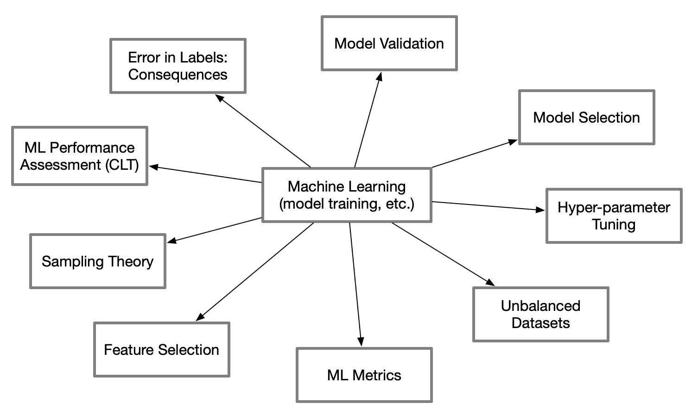
Model-Agnostic Topics

